Slide 1
A proposal for the
PISA 2018 Assessment of Global Competence
Andreas Schleicher
11 May 2016

Slide 2
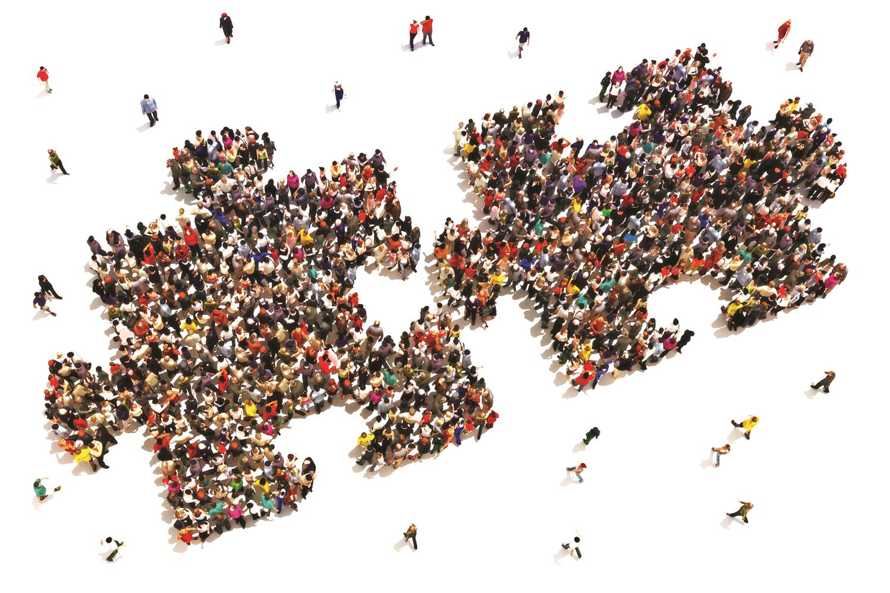

Slide 3
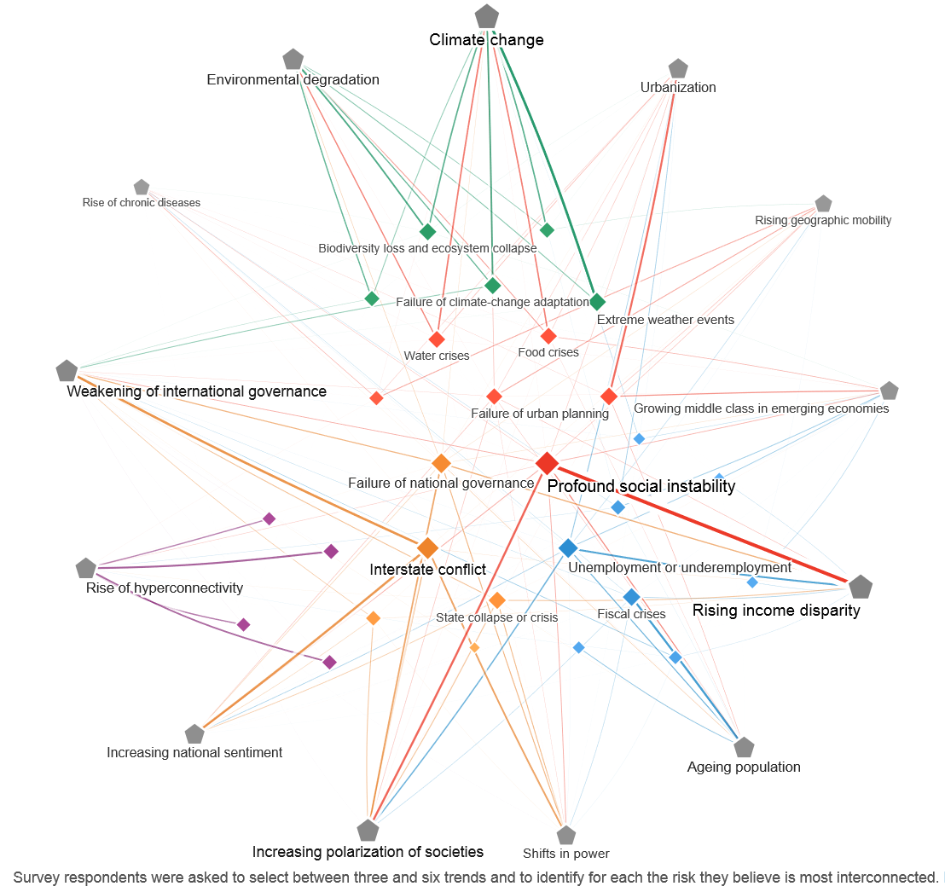
Source: WEF 2015 Global Risks

Slide 4
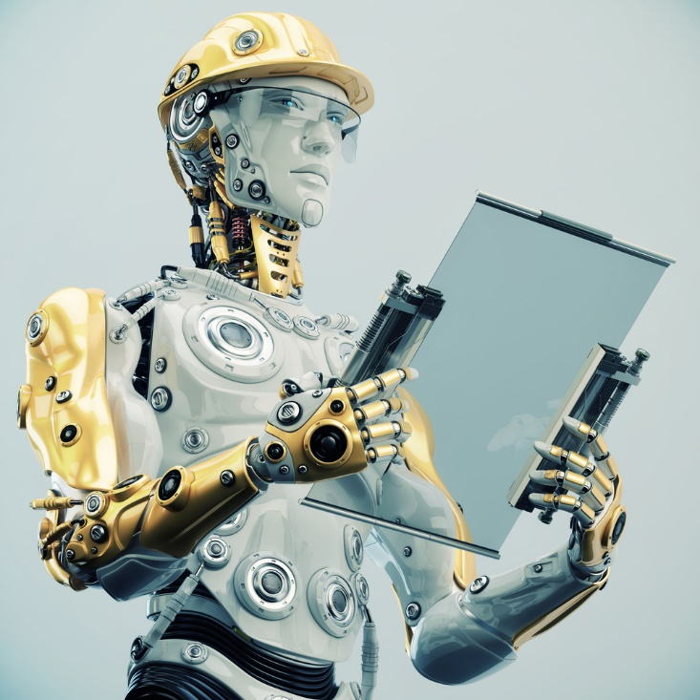
Robotics
Notes:
Or robotics. They run whole factories these days.

Slide 5
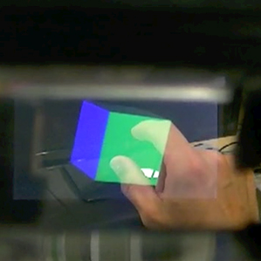
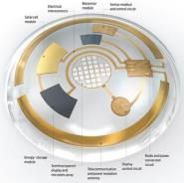
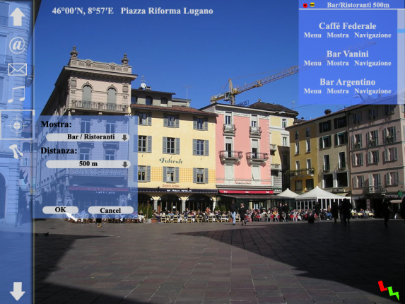
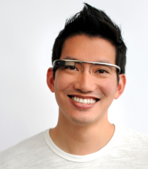
Augmented Reality
Inspired by: Center for curriculum redesign (CCR)
Notes:
Or think about augmented reality, the capacity to integrate the world’s knowledge into what we do in real time. The world no longer pays you for what you know – Google knows everything – but for what you can do with what you know.

Slide 6
Growing unequal
Gini Coefficients for OECD countries, in 1985 and 2008
Notes:
Income inequality is often represented by an index known as the Gini Coefficient for individual’s income within a population. In essence, the higher the figure, the greater the level of inequality in a country. Between 1985 and 2008 the coefficients reveal growing income inequality in most OECD countries. The highest level of inequality was measured in Mexico in both of the years shown in the figure above, followed by Turkey and the United States. Despite growing slightly during the period shown, Denmark and Norway had the lowest levels of income inequality. However, not all countries shared this general tendency. Belgium, France, and Hungary experience no change in income inequality across this time, while Greece and Turkey both saw decreases in income inequality, reversing the general trend. It is important to note that, as the latest figure available is from 2008, these trends do not take into account the impact of the recent financial crisis which is likely to have influenced the current conditions.
Despite increasing affluence in OECD countries, income inequality has been growing on average in OECD countries in the last 25 years. This widening gap in income equality seems to be due not to gender inequality or a growing divide between the poor and middle class. Rather, there is a growing divide between the middle class and the rich in many (though not all) OECD countries. At the same time, spending on social programmes has increased in every OECD member country. Education can play a role in addressing some of the causes of inequality by providing individuals from poorer backgrounds with the cognitive and social skills necessary to succeed in the modern world. However more can, and should, be done to support those least well‑off to achieve their goals in education and the workforce.

Slide 7
Home alone: the rise of single-person households
Number of one person households early-mid-2000s to 2025-2030 (projected)
Notes:
Traditional household structures are changing, with one of the most significant shifts being an increase in single‑person households, particularly in urban areas. In the early to mid‑2000s, England, France and New Zealand had the largest number of people living alone. By 2025‑30, those countries are forecast to be joined by a number of other OECD countries, including Austria, Germany, The Netherlands, Norway, and Switzerland. A number of social and demographic trends are pushing this increase: a rise in divorce rates, elderly women living longer, and the increasing mobility of young professionals. Although the financial crisis has slowed this trend in the short term, with young people delaying moving out from their childhood home until they are on a stronger economic footing, the overall rise in single‑person households is expected to continue. In the medium to long term, this trend raises questions about increasing alienation, which has been linked to higher levels of depression and ensuing health challenges, especially for the middle-aged and elderly.
Between the mid‑1980s and the mid‑2000s, there was a slow and continual decline in the number of persons per household across OECD countries. Both smaller families and in many countries the decreasing adherence to the custom of living with elderly relatives and grandparents are contributing to this trend. Mexico and Turkey are the countries most affected by these trends, with households shrinking from an average of around 4.5 people in the mid‑1980s to just 4 people per household in the mid‑2000s. Countries such as Ireland, Japan, Portugal and Spain have also seen a drop in numbers. On average across OECD countries, there were 2.6 people per household in the mid-2000s.
As a result of people having overall fewer children, and less people relying on intergenerational living arrangements, the size of households has also gone down across OECD countries in recent decades. These changes mean that children today are much less likely to grow up with numerous siblings, and are also less likely to live with their grandparents or extended family members. For education, the impact of these trends is felt directly by planners and local school authorities, who must cope with changing levels of enrolment and demand in their systems. The impact is also felt in the classroom, and by teachers in their interactions with both students and their families.

Slide 8
Increasing migration towards the developed world
Net migration (in millions of people) into regions, with countries grouped by income level and OECD members, 1960-2010.
Source : OECD (2013), Trends Shaping Education.
Primary source: World Bank (2012), World Databank: Net Migration.
Notes:
Note:
High income countries: are the most developed and the richest counties. They are defined as countries with gross national income (GNI) above $12,000. ( ex.: Germany, France, Chile, Argentina).
Middle income countries: are a diverse group by size, population and income level, and are home to 5 of the world’s 7 billion people and 73% of the world’s poor people (ex.: Brazil, China, India, South Africa).
Low income countries: are sometimes also referred to as developing countries with GNI per capita below $ 1,000. ( ex.: Afghanistan, Uganda, Haiti).

Slide 9
More culturally diverse societies
Percentage of young people (15-34) with a migration background
%
Source: OECD Indicators of Immigrant Integration, 2015

Slide 10



Second generation immigrant students’ performance in mathematics, by country of origin and destination
Country of origin and country of destination
2nd generation
students from
Turkey in:
First generation immigrant students’ performance in mathematics,
by country of origin and destination
1st generation
students from
Turkey in:

Slide 11


Immigrant students’ performance in mathematics, by country of origin and destination
Country of origin and country of destination
Students from
Arabic-speaking
countries in:
Percentage of students with an immigrant background
who reported that they feel like they belong at school
Students from
Arabic-speaking
countries in:
Students from
China in:

Slide 12
Schools can make a difference
Schools can
provide opportunities for young people to learn about global developments that affect the world and their lives
teach students how they can develop a fact-based and critical worldview of today
equip students with the means to access and analyse a broad range of cultural practices and meanings
engage students in experiences that facilitate international and intercultural relations
promote the value of diversity, which in turn encourages sensitivity, respect and appreciation.

Slide 13
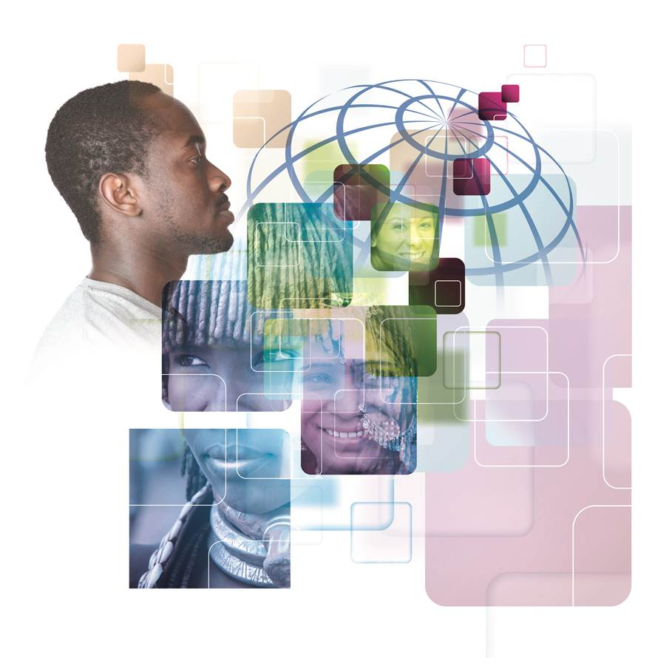
Global Competence in PISA

Slide 14
PISA definition of Global Competence
An overarching frame of reference encompassing multiple cognitive, social and emotional components, mediated and constrained by the belief that diversity should be valued as long as it does not violate human dignity
Global competence is the capacity to analyse global and intercultural issues critically and from multiple perspectives, to understand how differences affect perceptions, judgments, and ideas of self and others, and to engage in open, appropriate and effective interactions with others from different backgrounds on the basis of a shared respect for human dignity.

Slide 15
PISA definition of Global Competence
Global competence is the capacity to analyse global and intercultural issues critically and from multiple perspectives, to understand how differences affect perceptions, judgments, and ideas of self and others, and to engage in open, appropriate and effective interactions with others from different backgrounds on the basis of a shared respect for human dignity.

Slide 16
PISA definition of Global Competence
“open” means that all participants in the interaction demonstrate sensitivity towards, curiosity about and willingness to engage with others and their perspectives
Global competence is the capacity to analyse global and intercultural issues critically and from multiple perspectives, to understand how differences affect perceptions, judgments, and ideas of self and others, and to engage in open, appropriate and effective interactions with others from different backgrounds on the basis of a shared respect for human dignity.

Slide 17
PISA definition of Global Competence
Global competence is the capacity to analyse global and intercultural issues critically and from multiple perspectives, to understand how differences affect perceptions, judgments, and ideas of self and others, and to engage in open, appropriate and effective interactions with others from different backgrounds on the basis of a shared respect for human dignity.
“appropriate” means that all participants in the situation are equally satisfied that the interaction occurs within expected cultural norms

Slide 18
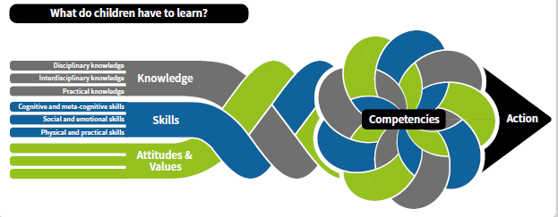
PISA definition of Global Competence

Slide 19
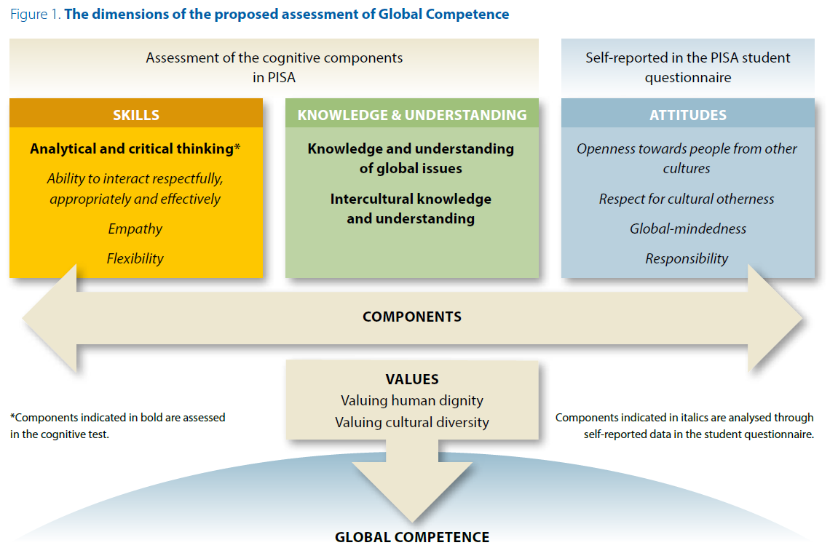
Attitudes themselves can be structured around values. Values transcend specific actions and contexts, have a normative prescriptive quality about what ought to be done or thought in different situations, and may be used to guide individuals’ attitudes, judgements and actions.
In PISA, valuing human dignity and valuing cultural diversity are explicitly included as critical filters through which individuals process information about others’ differences and the world, and are key references for critical and informed judgement.
“Skills”, are the capacities for carrying out a complex pattern of either thinking (in the case of a cognitive skill) or behaviour (in the case of a behavioural skill) in order to achieve a particular goal.
Global Competence requires numerous skills, including the ability to: communicate in more than one language; communicate appropriately and effectively with people from other cultures or countries; comprehend other people’s thoughts, beliefs and feelings, and see the world from their perspectives; adjust one’s thoughts, feelings or behaviours to fit new contexts and situations; and analyse and think critically in order to scrutinise and appraise information and meanings
An individual may have a large range of knowledge,
understanding and skills, but lack the disposition to use them. An “attitude” may be defined as the overall mind-set which an individual adopts and typically consists of four components: a belief or opinion about the object, an emotion or feeling towards the object, an evaluation (either positive or negative) of the object, and a tendency to behave in a particular way towards that object.

Slide 20
The instruments
Cognitive test
Covers the components of knowledge, understanding and critical thinking on global and intercultural issues
Self-reported information
Covers the other skills identified in the framework (ability to interact with different people, empathy, flexibility) and the attitudes towards diversity (openness towards other cultures; respect for cultural otherness; global-mindedness)

Slide 21
The cognitive test – from information to knowledge and critical understanding of global issues
The PISA test will assess how students can use their knowledge and critical thinking skills to understand issues of critical importance to the world (e.g. climate change, poverty) and issues that affect open and respectful interactions across cultures (e.g. cultural stereotypes).
Content Areas
Process
Outcome
Global Issues
Intercultural issues
Global and Intercultural Understanding
Application of Knowledge &
Critical thinking

Slide 22
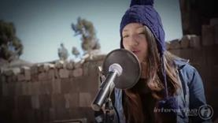
How the test works
Students read a case study on a global or intercultural issue…
..and use their knowledge and critical thinking…
…to answer questions about the case
In this youtube video that reached over 1.5 million visualizations, Renata Flores sings in Quechua, her native tongue, to Michael Jackson's "The Way You Make Me Feel,” against the backdrop of ancient Inca ruins.
Q1. What messages do you think Renata is trying to convey?
(Open Constructed response)
Q2. What is true about minority languages? (True/False)
Many kids do not speak their heritage language because it is not “cool”
Education in one single national language has accelerated the disappearance of many minority languages
…

Slide 23
What is going to be tested and scaled
The student
Has knowledge and critical understanding of the self
Has knowledge and critical understanding of global issues
Has knowledge and critical understanding of communication in intercultural contexts
Can identify solutions for issues within local and global contexts
Has knowledge and critical understanding of cultural issues
Can assess evidence on global issues in a balanced and reflective way
Can produce reasoned arguments on global issues based on evidence
Can recognize cultural stereotypes
Can distinguish between facts and assertions on global issues and cultural differences

Slide 24
Scoring of responses
Students’ performance on the cognitive test will be reported on a multi-dimensional scale measuring to what extent students are able to use their knowledge, understand meanings, recognize relationships and perspectives, and think critically about global or intercultural issues.
The test will include a limited number of short constructed response items, for which internationally valid scoring rubrics will be developed.
Partial credit scoring will be used in all cases where multiple correct answers are possible.

Slide 25
Other features of the cognitive test
The scenarios will be based on real news (properly decontextualized) and « critical incidents » (e.g. a communication problem between students from two different cultural groups).
  The 1-hour, computer-based test will provide a paced sequence of tasks for each scenario that replicate the cognitive challenges (and in some cases simulate the interactions) of a case study exercise in the classroom.
The scenarios used in the test will be adjudicated by countries to minimize cultural bias.
The items will not require specific knowledge (e.g. what is the language of the indigenous in Bolivia) but general knowledge/awareness of relevant global and inter-cultural issues (e.g. on the role of language for cultural diversity).
The PISA test is thus not a quiz but an innovative assessment of informed and critical thinking about global and intercultural issues.

Slide 26
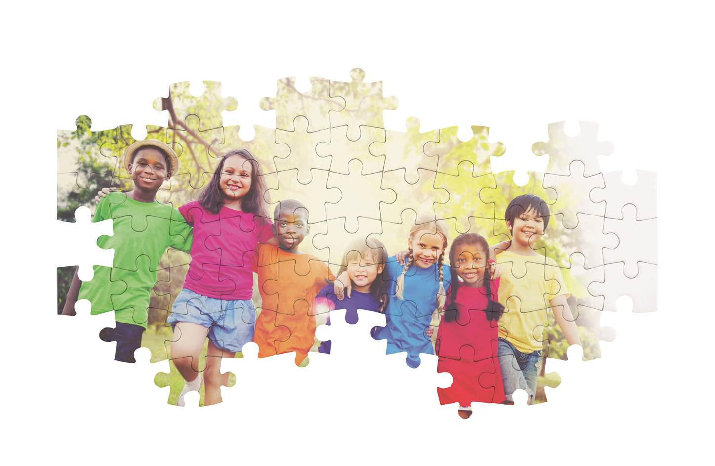
PISA student context questionnaires

Slide 27
PISA student context questionnaires
Interacting respectfully
Knowing and understanding intercultural issues
Empathy
Openness to other cultures
Respon-sibility
Respect for cultural otherness
Knowledge and understanding of intercultural interactions and culture. It involves knowledge about one’s own culture, other cultures, and the similarities and differences between cultures
This component is not acquired by factual knowledge alone, but rather through the ability to find the meanings of and the connections between different pieces of information, in other words, through understanding.
Misconceptions are often the result of lack of information. Humans learn by creating classification systems, and so prejudice and stereotypes can emerge when minimal new knowledge leads to over-simple categorisations and generalisations.
Self-reported information on skills and attitudes

Slide 28
PISA student context questionnaires
Interacting respectfully
Knowing and understanding intercultural issues
Empathy
Openness to other cultures
Respon-sibility
Respect for cultural otherness
Linguistic, communication and behavioural skills that are required to interact respectfully, appropriately and effectively with other people, to manage breakdowns in communication, and to mediate between speakers of different languages or cultures.
Ability to adapt one’s thinking, behaviours and actions according to the prevailing cultural environment, or to novel situations and contexts that might present new demands or challenges
Appropriate and effective intercultural interactions require not only knowledge of the other’s language but also the ability to communicate transparently in one’s own language, in a style that reduces the risk of misunderstandings, and discloses and elicits key information in order to help build trust and mutual understanding.
Self-reported information on skills and attitudes

Slide 29
PISA student context questionnaires
Interacting respectfully
Knowing and understanding intercultural issues
Empathy
Openness to other cultures
Respon-sibility
Respect for cultural otherness
Culturally empathic learners retain their separate cultural identity but are simultaneously aware of the cultural values and beliefs of the people with different cultural background
Cognitive perspective-taking, which involves apprehending and imagining the perceptions, thoughts and beliefs of other people;
Affective perspective-taking, which involves apprehending and imagining the emotions, feelings and needs of other people;
Sympathy, which additionally involves feelings of compassion and concern for other people based on apprehending their cognitive or affective state or condition or their material situation or circumstances.
Self-reported information on skills and attitudes

Slide 30
PISA student context questionnaires
Interacting respectfully
Knowing and understanding intercultural issues
Empathy
Openness to other cultures
Respon-sibility
Respect for cultural otherness
Openness towards people from other cultures involves sensitivity towards, curiosity about and willingness to engage with other people and other perspectives on the world
An active willingness to seek out and take up opportunities to engage with people from other cultures, to discover and learn about their cultural perspectives and how they interpret familiar and unfamiliar phenomena and artefacts, and to learn about their linguistic, communicative and interactional conventions.
Willingness to suspend own cultural values, beliefs and behaviours when interacting with culturally diverse others and not to assume that they are the only possible and naturally correct ones.
Self-reported information on skills and attitudes

Slide 31
PISA student context questionnaires
Interacting respectfully
Knowing and understanding intercultural issues
Empathy
Openness to other cultures
Respon-sibility
Respect for cultural otherness
Respect for cultural otherness, consisting of positive regard and esteem for someone or something based on the judgment that they have intrinsic importance, worth or value
Global mindedness is defined as “a worldview in which ones sees oneself as connected to the world community and feels a sense of responsibility for its members
Self-reported information on skills and attitudes

Slide 32
PISA student context questionnaires
Interacting respectfully
Knowing and understanding intercultural issues
Empathy
Openness to other cultures
Respon-sibility
Respect for cultural otherness
Responsibility is an attitude towards one’s own actions. It involves being reflective about one’s actions, forming intentions about how to act in an appropriate way on the basis of a value or set of values, and holding oneself accountable for the outcomes of those actions.
Responsibility can require courage insofar as taking a stance may entail taking action against the norms of a community, or challenging a collective decision that is judged to be wrong.
Self-reported information on skills and attitudes

Slide 33
The role of values:
Respect and a belief in human dignity
Overemphasising diversity can undermine the legitimacy of any core values at all. Risks that sensitivity to other viewpoints descends into cultural relativism
Strengthening common core values
Appreciating the diversity of values
Enforcing an artificial uniformity of values damages people's capacity to acknowledge different perspectives

Slide 34
School and teacher questionnaires
School and the teacher questionnaires will provide information about:
Teachers’ beliefs about diversity and inclusion policies at school
Curriculum coverage of global issues (climate change, international conflicts…)
Curriculum coverage of the histories and culture (e.g. beliefs, norms, values, customs, or arts) of diverse cultural groups
Schools’ activities for multicultural learning (e.g. cultural events, exchange programmes)
Teachers’ practices to facilitate interactions and peer-to-peer learning between diverse students
School policies to facilitate the integration of immigrants and non-native speakers
Teachers’ professional experience and training in intercultural communication and in teaching multicultural classes
Teachers’ self-efficacy in multicultural environments

Slide 35
Some questions PISA seeks to answer
How well are students prepared for life and employment in culturally diverse societies and in a globalised world?
How much are students exposed to global news and how do they understand and critically analyse intercultural and global issues?
What approaches to multicultural, intercultural and global education are used at school?
What approaches are used to educate culturally diverse students and how are schools leveraging this diversity to develop students’ global competence?
What approaches are used to stimulate peer-to-peer learning between students from different cultures?
How well are schools contesting cultural and gender biases and stereotypes, including their own?

Slide 36
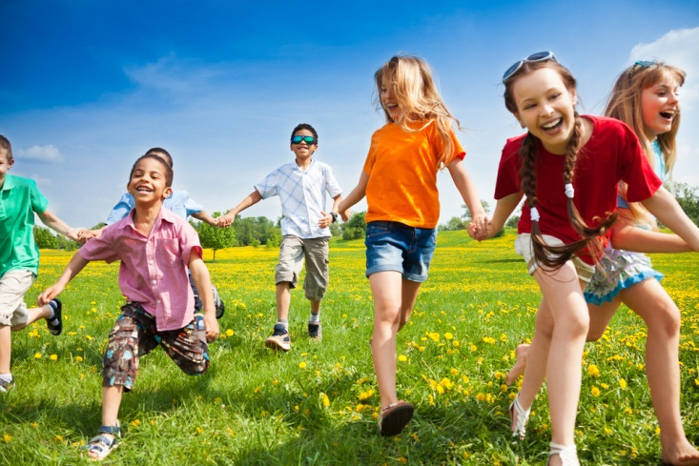
Thank you
  Find out more about our work at www.oecd.org
    All publications
    The complete micro-level database
  Email: Andreas.Schleicher@OECD.org
  Twitter: SchleicherEDU
  and remember:
  Without data, you are just another person with an opinion

